Slide 1
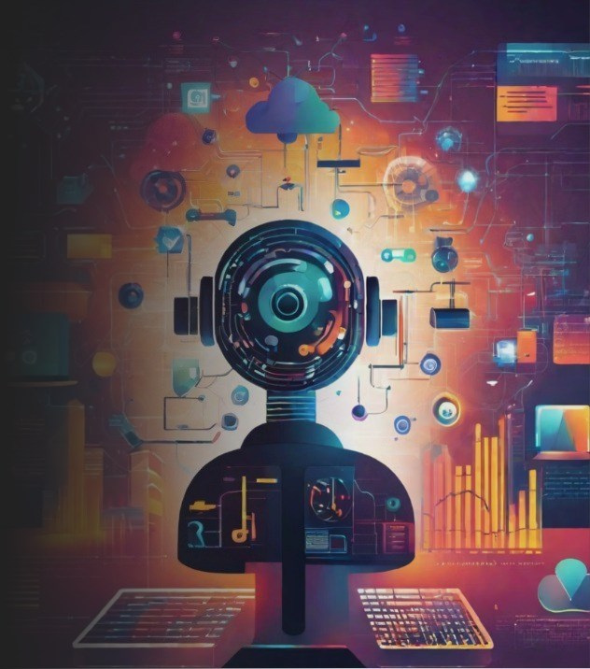
Image generated by Canva AI Generator
28 NOVEMBER 2023
AI TOOLS
For Event & Association Professionals
Presented by: Angela Guillemet
angela@incon-pco.com

Slide 2
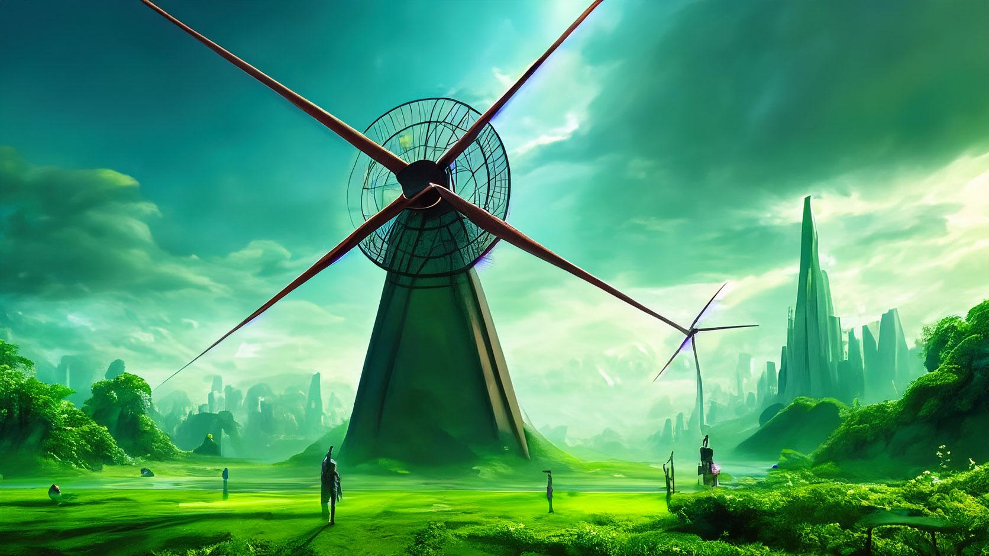
Image generated by Adobe Photoshop AI Generator
“when the winds of change blow, some people build walls and others build windmills.”
Notes:
AI tools help association serve members & event organisers serve clients and their delegates better
They off us opportunities to diversify our skills, be inspired, more creative and more productive
This can help us with job security
And can bring value both inside and outside the job

Slide 3
How can AI help Associations
Automate the routine
Member personalisation
Marketing & Content Creation
Data insights & search
Learning, education tailoring
New revenue streams
Event Planning
Image generated by WePik AI
Notes:
Automate the routine - giving you more time to focus on your members - increase your productivity and complements human creativity, inspires, assists and enhances processes, frees up time to focus on things we enjoy,supports you to upskill and grow
Member Experiences: personalisation, recommends content based on preferences and interactions.
Marketing: helps inspire, improves visuals, graphics content, social media posts - to reach, engage target and recruit members.
Data: valuable insights and trends, segmentation, predict behaviors, identify risks
Learning: can enhance educational programs by tailoring and recommending pathways
New revenue streams - new markets, new members, new revenue
Automation: of repetitive tasks, such as minute taking, social posts, data entry
Member support: chatbots can answer questions and guide members
Event Planning: analyzing data to predict attendance, personalise event experiences and create modern, magnificent graphics/stands designs

Slide 4
Useful AI Tools
Compiled by
MAX AI
DALL-E
MIDJOURNEY AI
CANVA
RECRAFT.AI
D-ID
BEAUTIFUL.AI
PICTORY
9. FILMORA
10. PROJECT SPARK
GRAMMARLY
The Chatbots
CLAUDE
ChatGPT
BARD

Slide 5
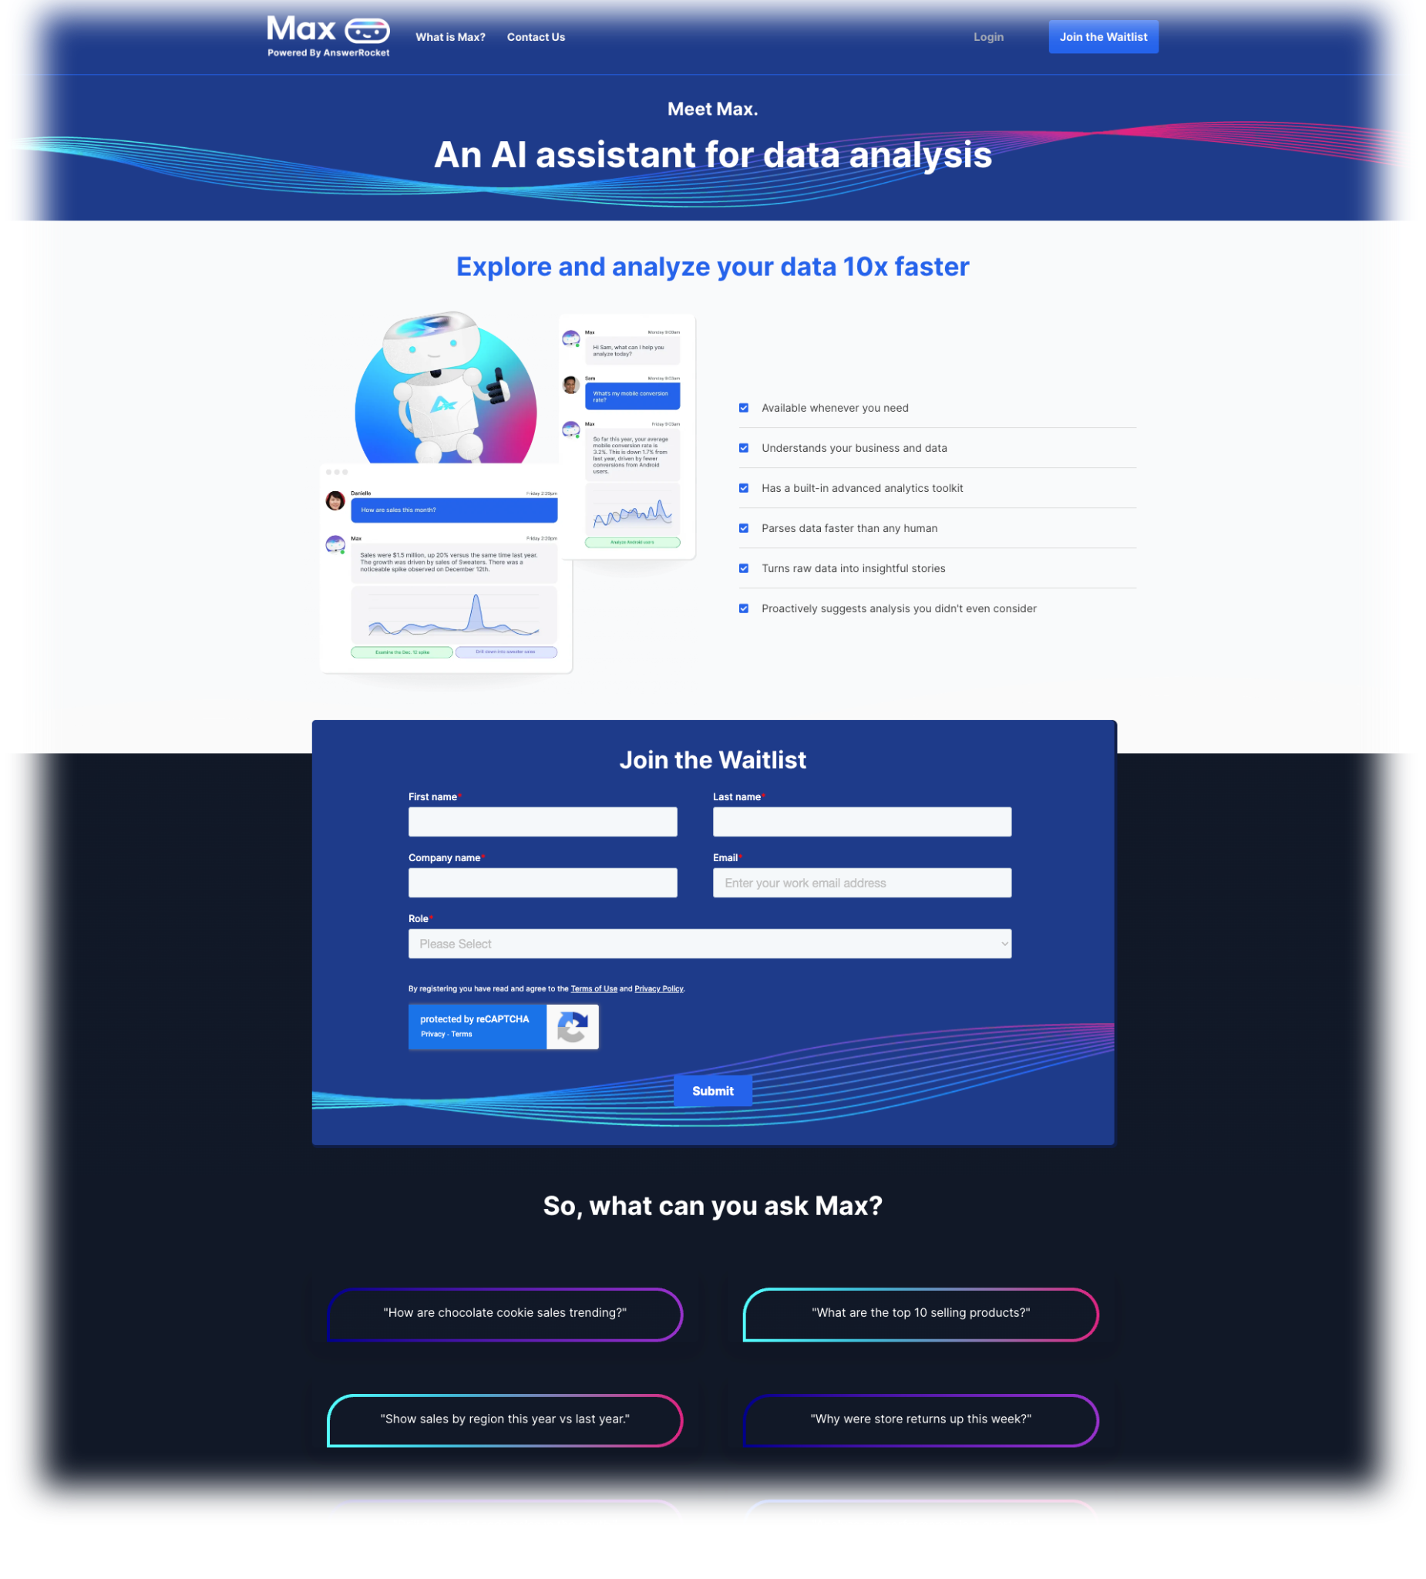
MAX.AI
Free with daily limit with paid option
Easy to use
AI assistant gives direct access to all chatbots on your browser - Chrome or Microsoft
Saves time switching tabs - can be used on the same web page you are on
Used to do the usual: summarise documents, refine emails etc
Notes:
It is Google Chrome or Microsoft Edge extension that link the chatbots.
Its beauty is that it not only uses ChatGPT, but also utilizes other AI chatbots like Bard, Claude, and Bing Chat.
The main benefit of using MaxAI over chatbots is that during the writing process, you will not need to open the AI tool separately; instead, you can use the AI directly on the same web page you are working on. This saves time that would otherwise be spent on switching tabs or windows and copying/pasting queries or responses.
Enhance your productivity to the next level for tasks such as writing, translating, summarizing, etc

Slide 6
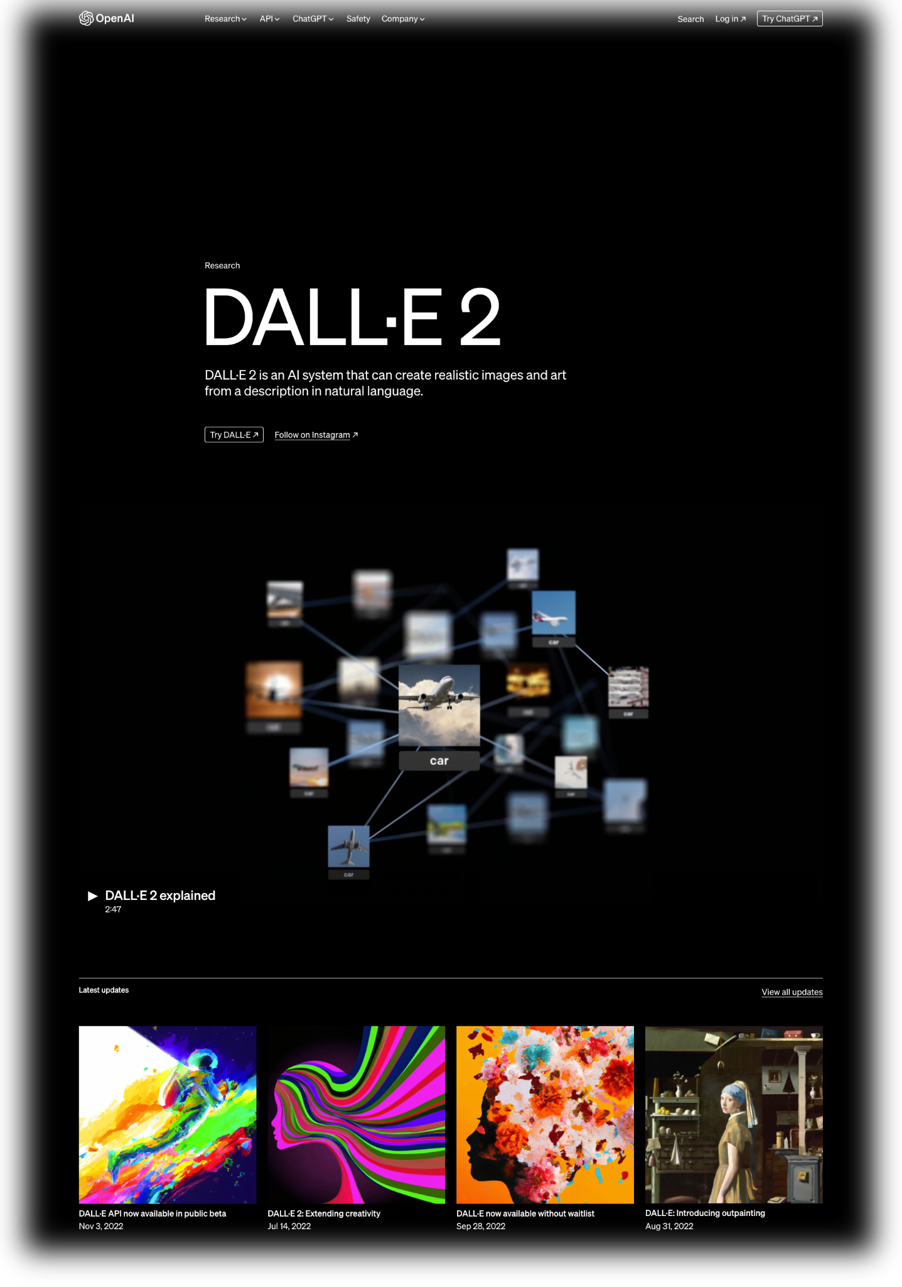
DALL-E
Limited free trial
Takes some training to get familiar with it
Inspires creativity with high-quality images by feeding it textual descriptions of what you envision.
Can be used by associations or in events for creating visuals or tailored marketing collateral simply.
Developed by OpenAI.

Slide 7
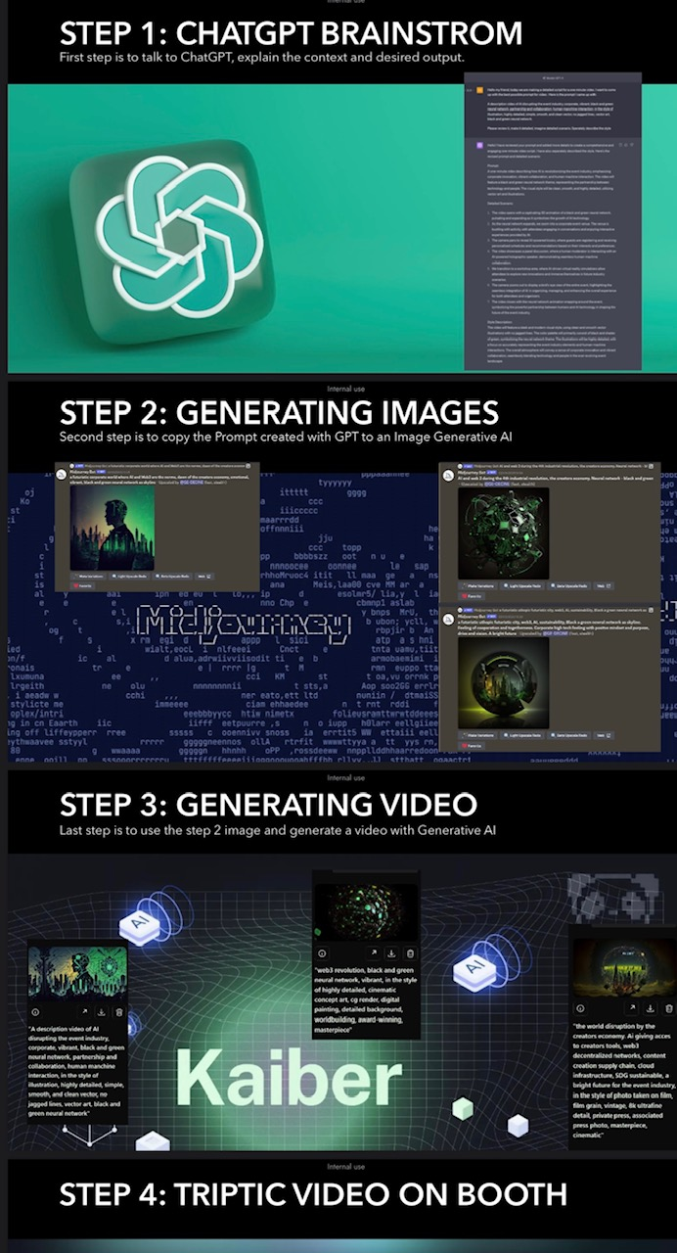
MIDJOURNEY
Limited free trial
Takes some training to get familiar with it
Visual creativity and idea generator. Text To Image functionality.
Helps turn ideas into visuals Just enter your text, pick a style, and be inspired!
Brainstorm using Chat and then copy prompt into Midjourney
Notes:
It is Google Chrome or Microsoft Edge extension that link the chatbots.
Its beauty is that it not only uses ChatGPT, but also utilizes other AI chatbots like Bard, Claude, and Bing Chat.
The main benefit of using MaxAI over chatbots is that during the writing process, you will not need to open the AI tool separately; instead, you can use the AI directly on the same web page you are working on. This saves time that would otherwise be spent on switching tabs or windows and copying/pasting queries or responses.
Enhance your productivity to the next level for tasks such as writing, translating, summarizing, etc

Slide 8
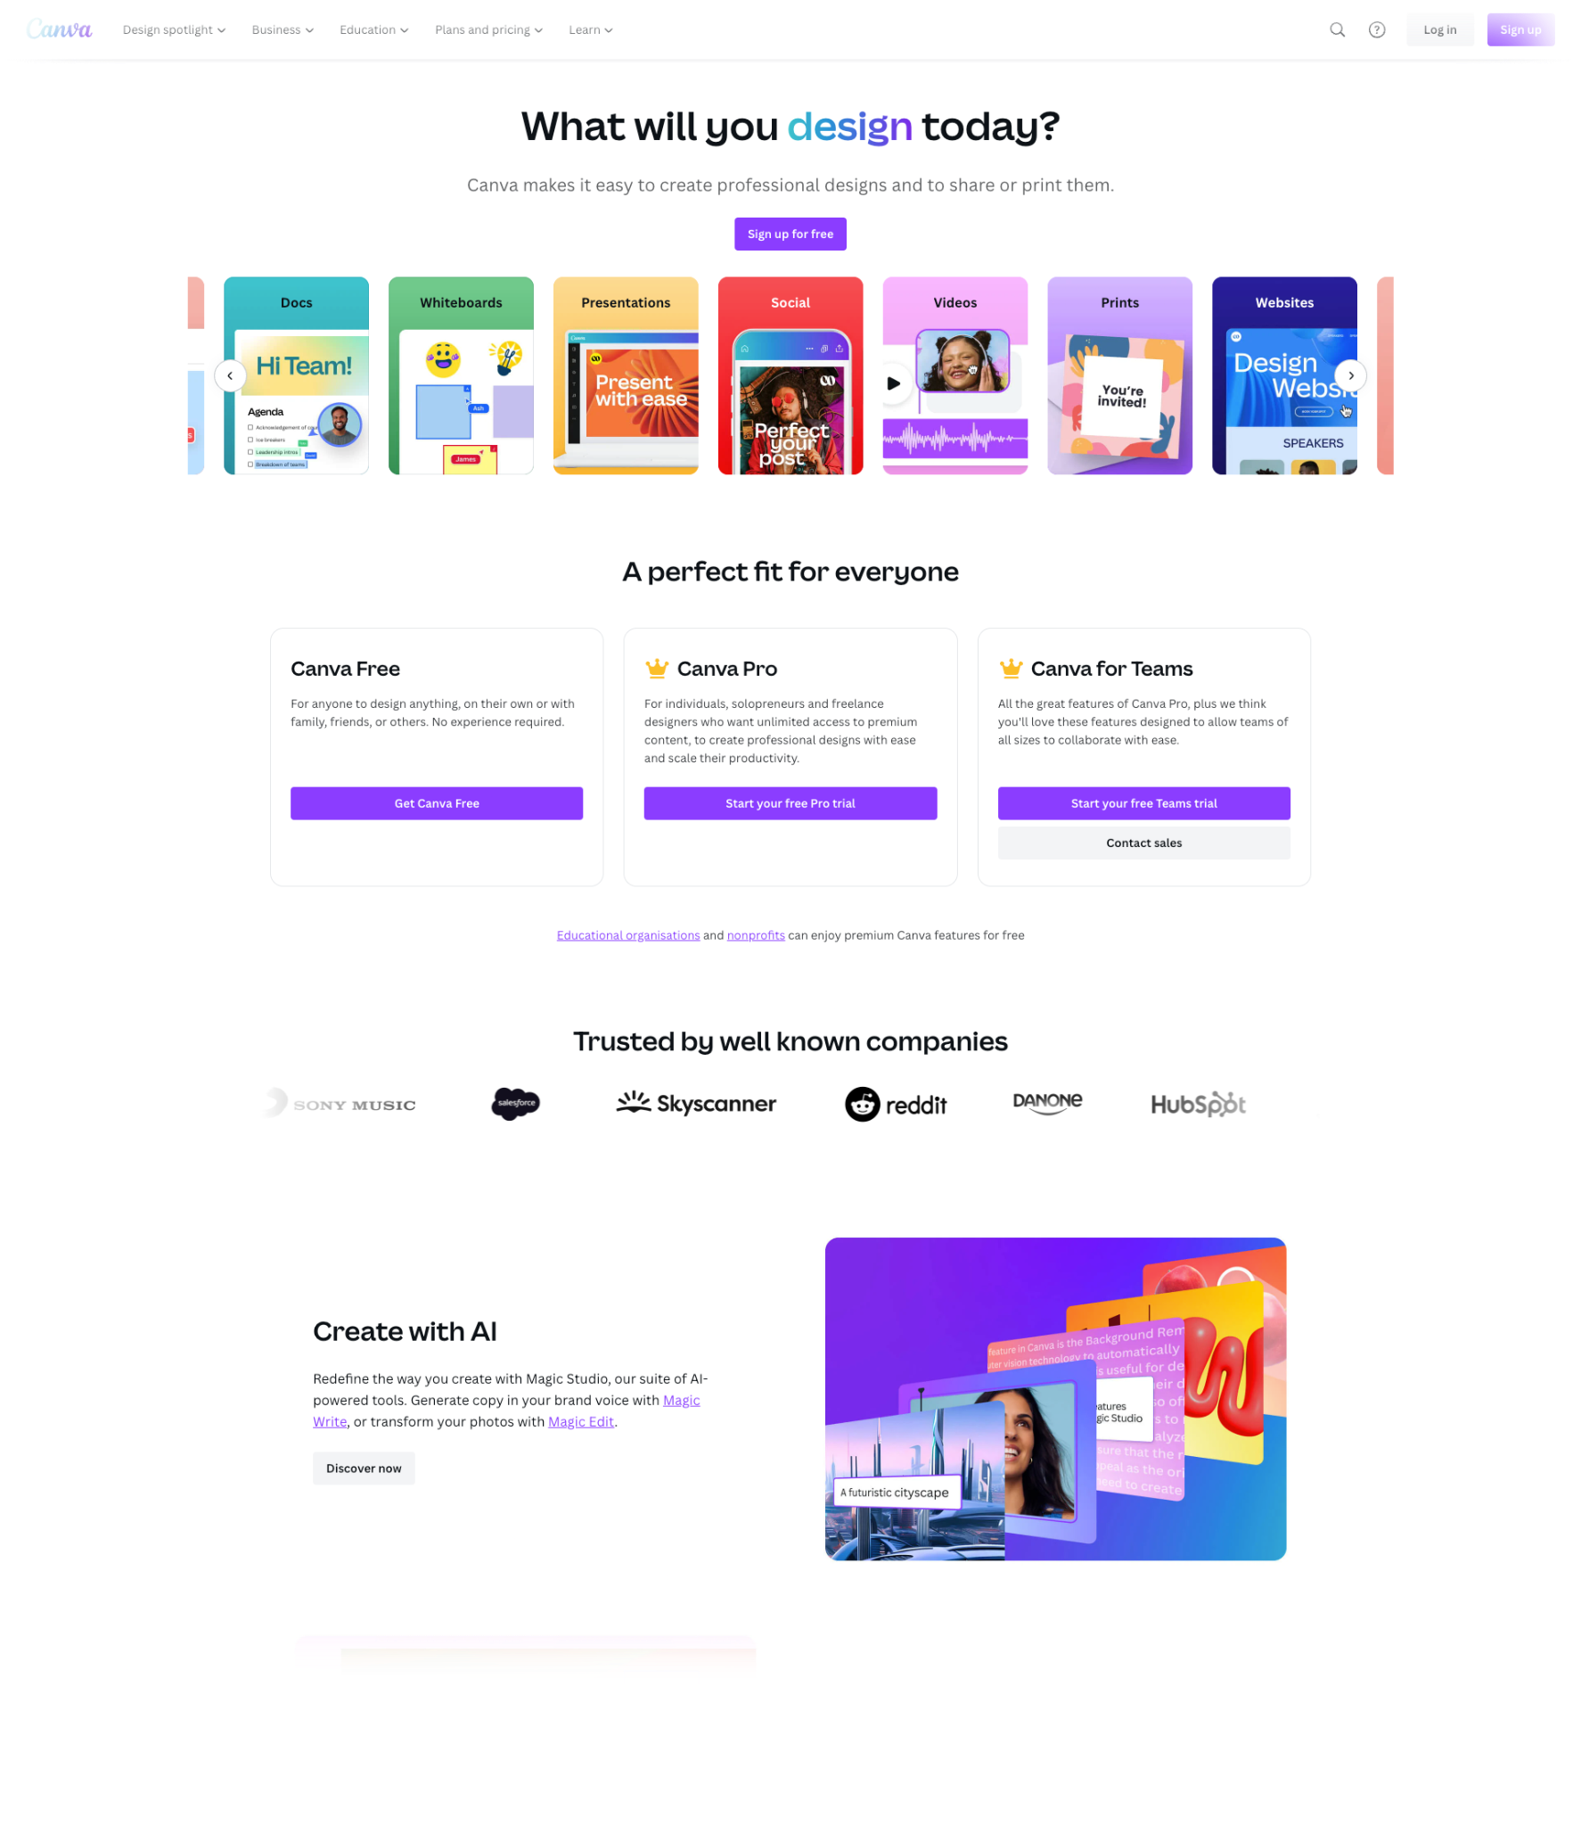
CANVA
Some free features
Easy to use
Makes graphic design simple, faster, cheaper
Magic media - descriptions to generate visuals
Create social media posts, presentations, posters, videos,
Upload association brand identity,
Notes:
Create social media posts, presentations, posters, videos,

Slide 9
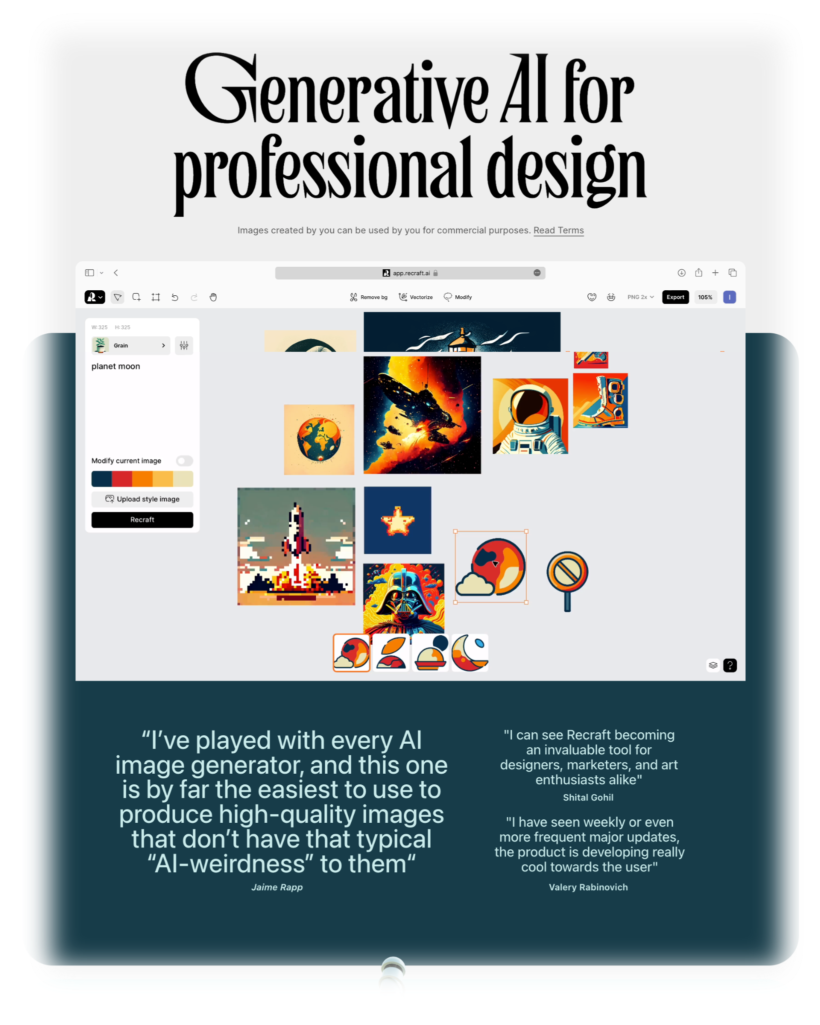
RECRAFT.AI
Free with paid option
Easy to use
Generates images and graphics in different formats and styles.
Edit and recolour images
Use AI upscaling, and create vector graphics and icons
Multiple image options and variable functions available.

Slide 10
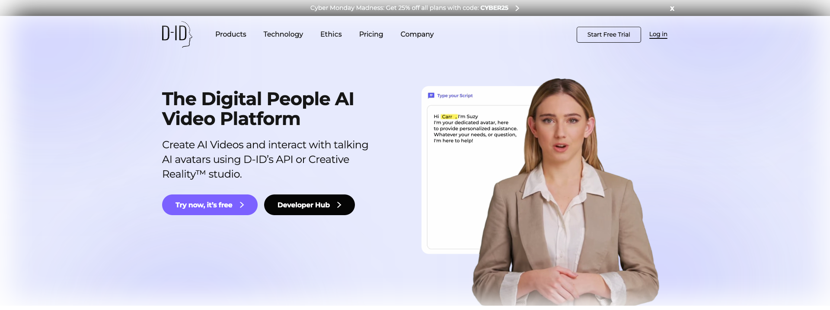
DI-D
Limited free trial
Takes some training to get familiar with it
Turns photos into video. Talking head of you. Animated historic photos
Use for personalised welcome messages, FAQ, learning materials and manuals

Slide 11
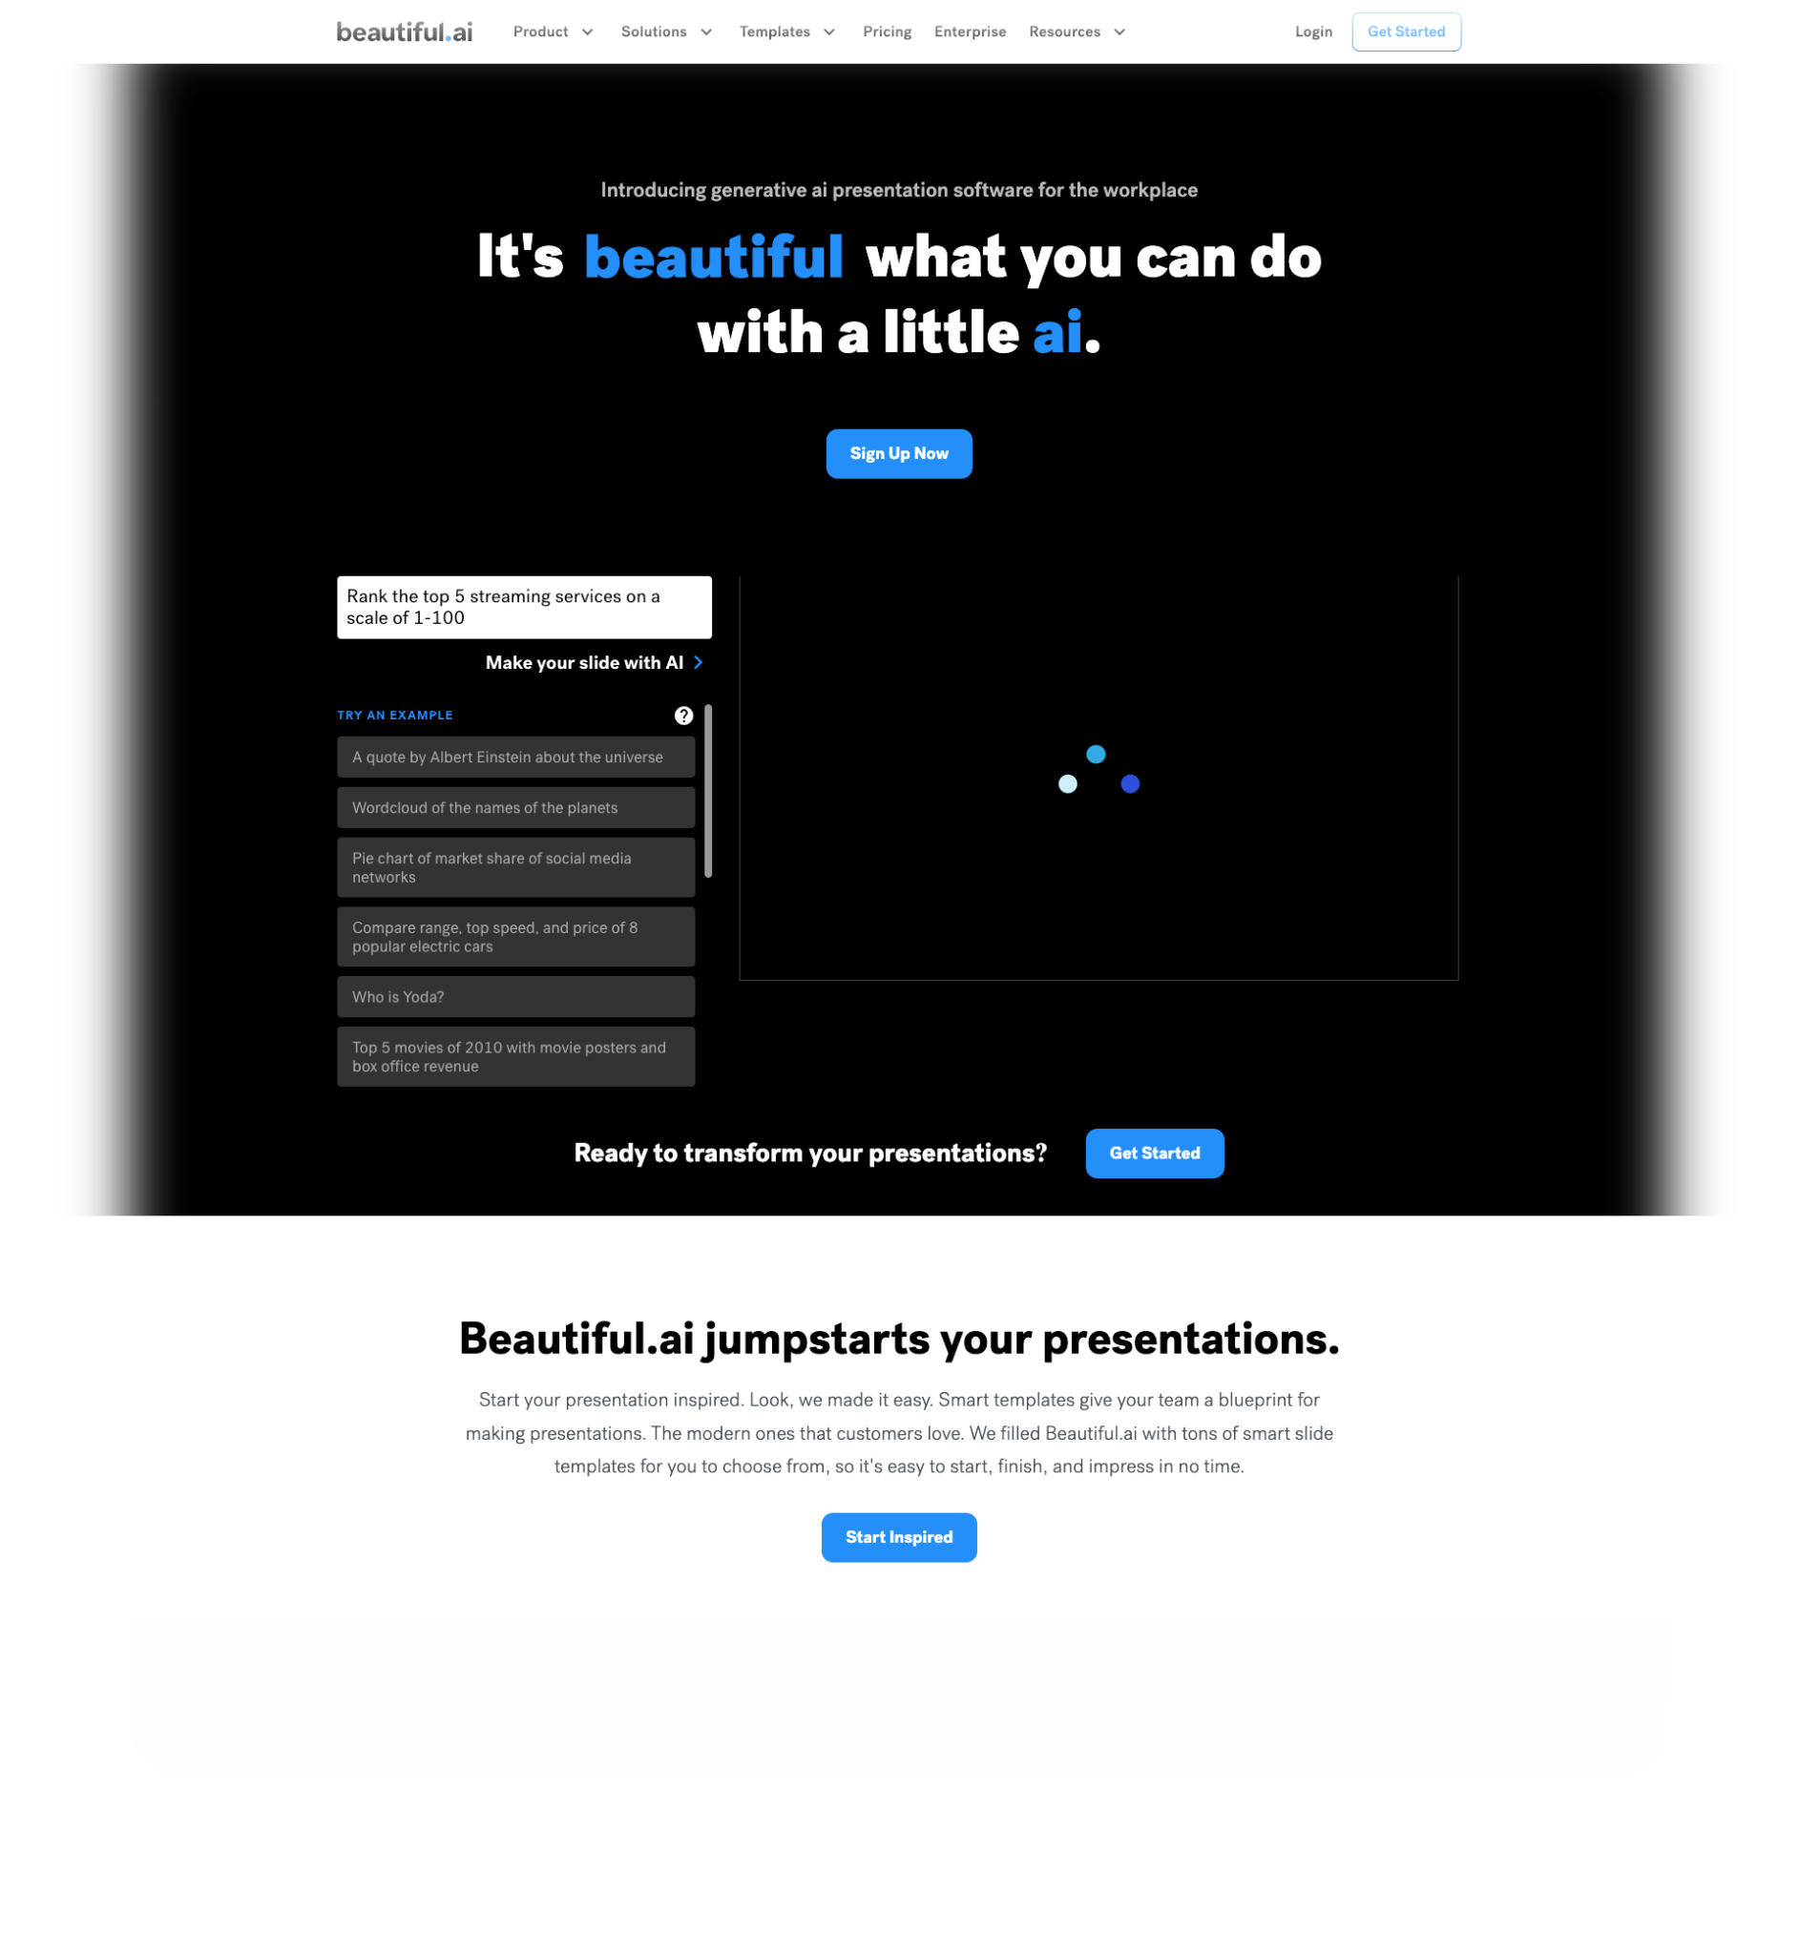
BEAUTIFUL.AI
Paid Subscription
Easy to use
Creative presentations with pre-designed layouts, library of images, and AI-powered features like text rewrite options and ‎dynamic data updates
Notes:
It is Google Chrome or Microsoft Edge extension that link the chatbots.
Its beauty is that it not only uses ChatGPT, but also utilizes other AI chatbots like Bard, Claude, and Bing Chat.
The main benefit of using MaxAI over chatbots is that during the writing process, you will not need to open the AI tool separately; instead, you can use the AI directly on the same web page you are working on. This saves time that would otherwise be spent on switching tabs or windows and copying/pasting queries or responses.
Enhance your productivity to the next level for tasks such as writing, translating, summarizing, etc

Slide 12
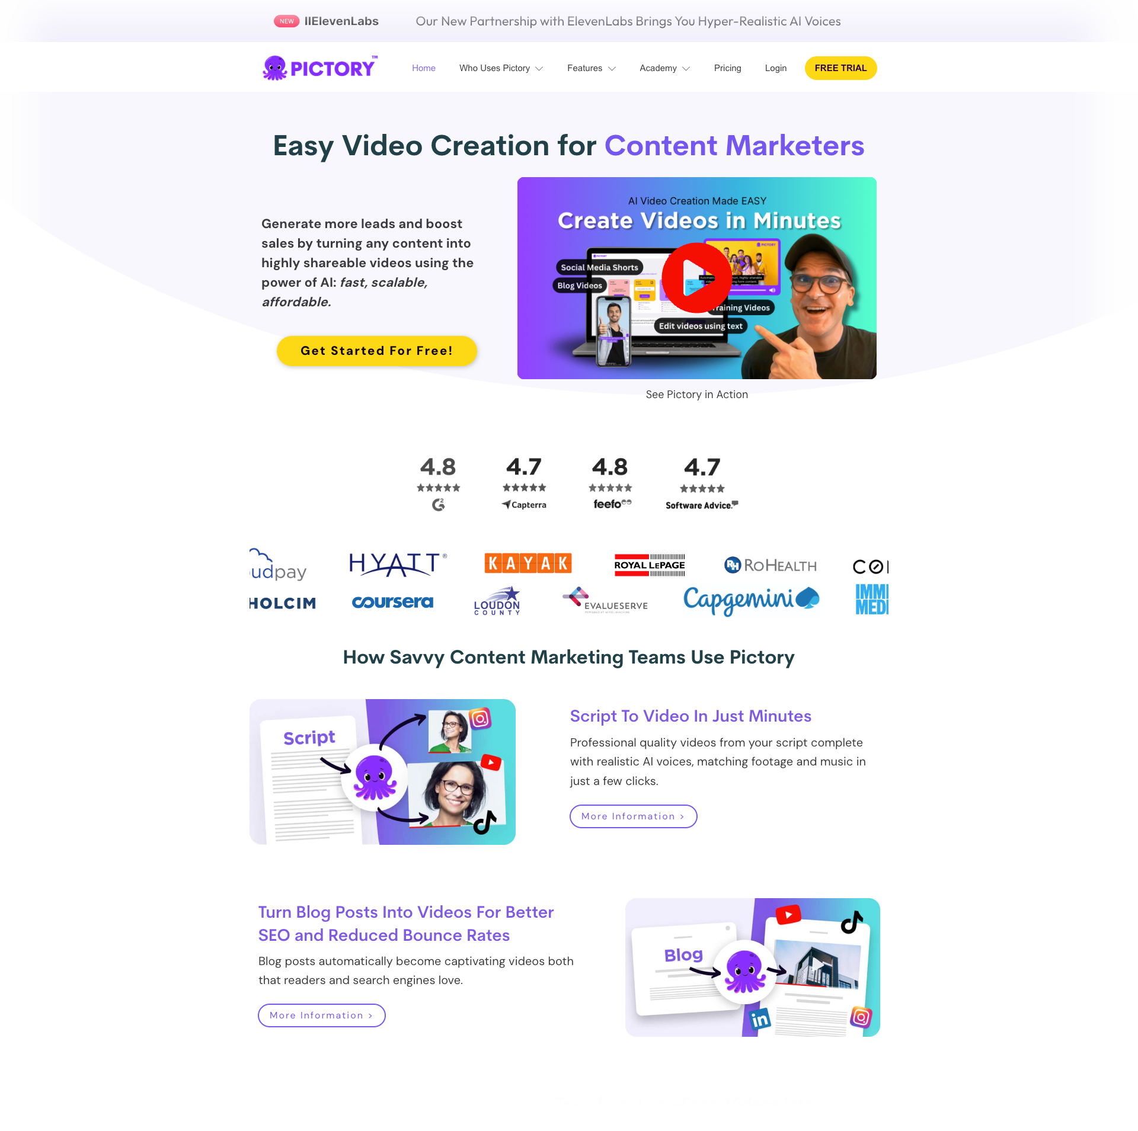
PICTORY
Some free features
Easy to use
Video generator for member marketing, event videos.
Personalise videos for your different member segments

Slide 13
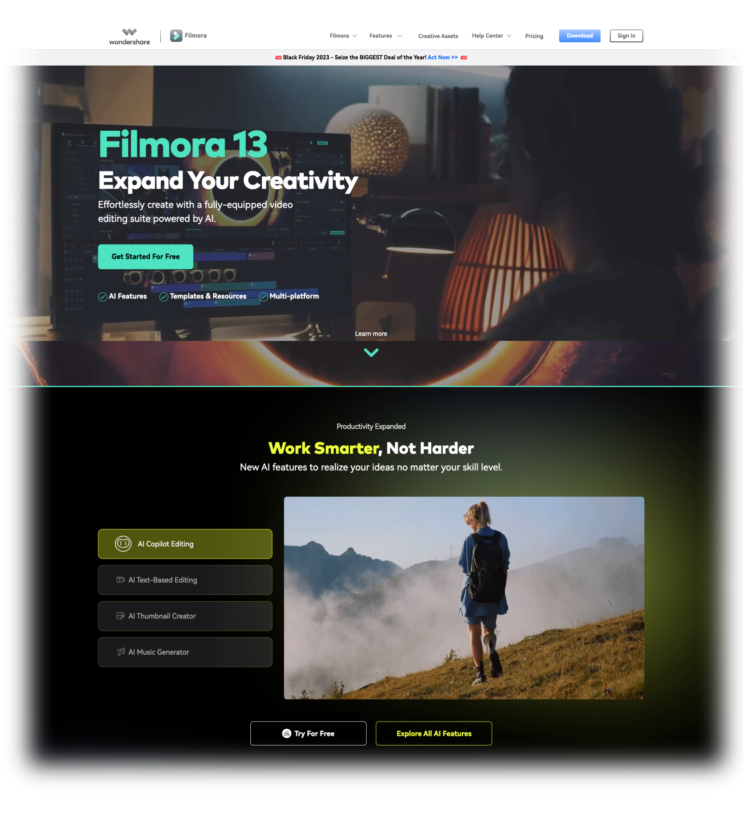
FILMORA
Some free features
Easy to use
Video generator for member marketing, event videos.
Personalise videos for your different member segments
Notes:
It is Google Chrome or Microsoft Edge extension that link the chatbots.
Its beauty is that it not only uses ChatGPT, but also utilizes other AI chatbots like Bard, Claude, and Bing Chat.
The main benefit of using MaxAI over chatbots is that during the writing process, you will not need to open the AI tool separately; instead, you can use the AI directly on the same web page you are working on. This saves time that would otherwise be spent on switching tabs or windows and copying/pasting queries or responses.
Enhance your productivity to the next level for tasks such as writing, translating, summarizing, etc

Slide 14
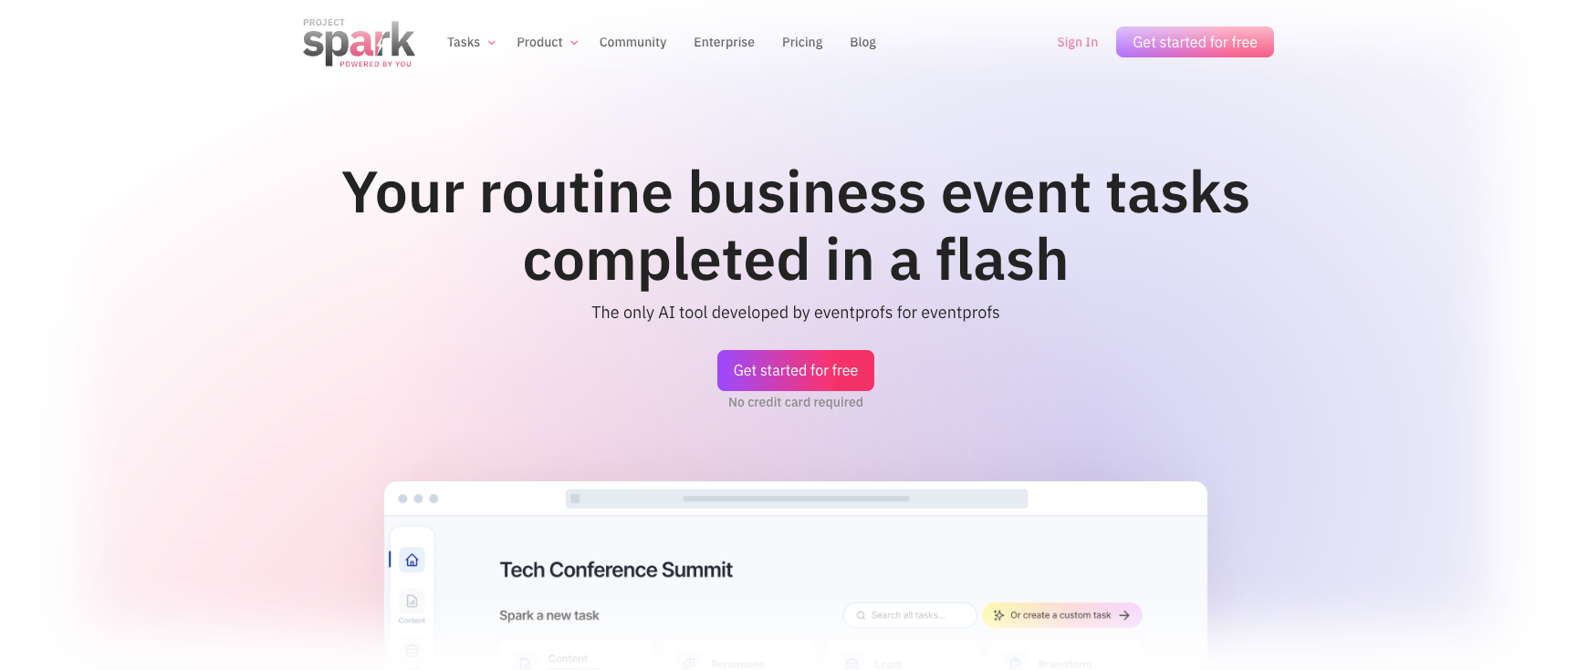
PROJECT SPARK
Free
Takes some training to get familiar with it
AI developed by Event Profs to make event planning more efficient and creative. Assists with building agendas, generating session descriptions, speaker bios, questions, promotional emails, and repurposing content.

Slide 15
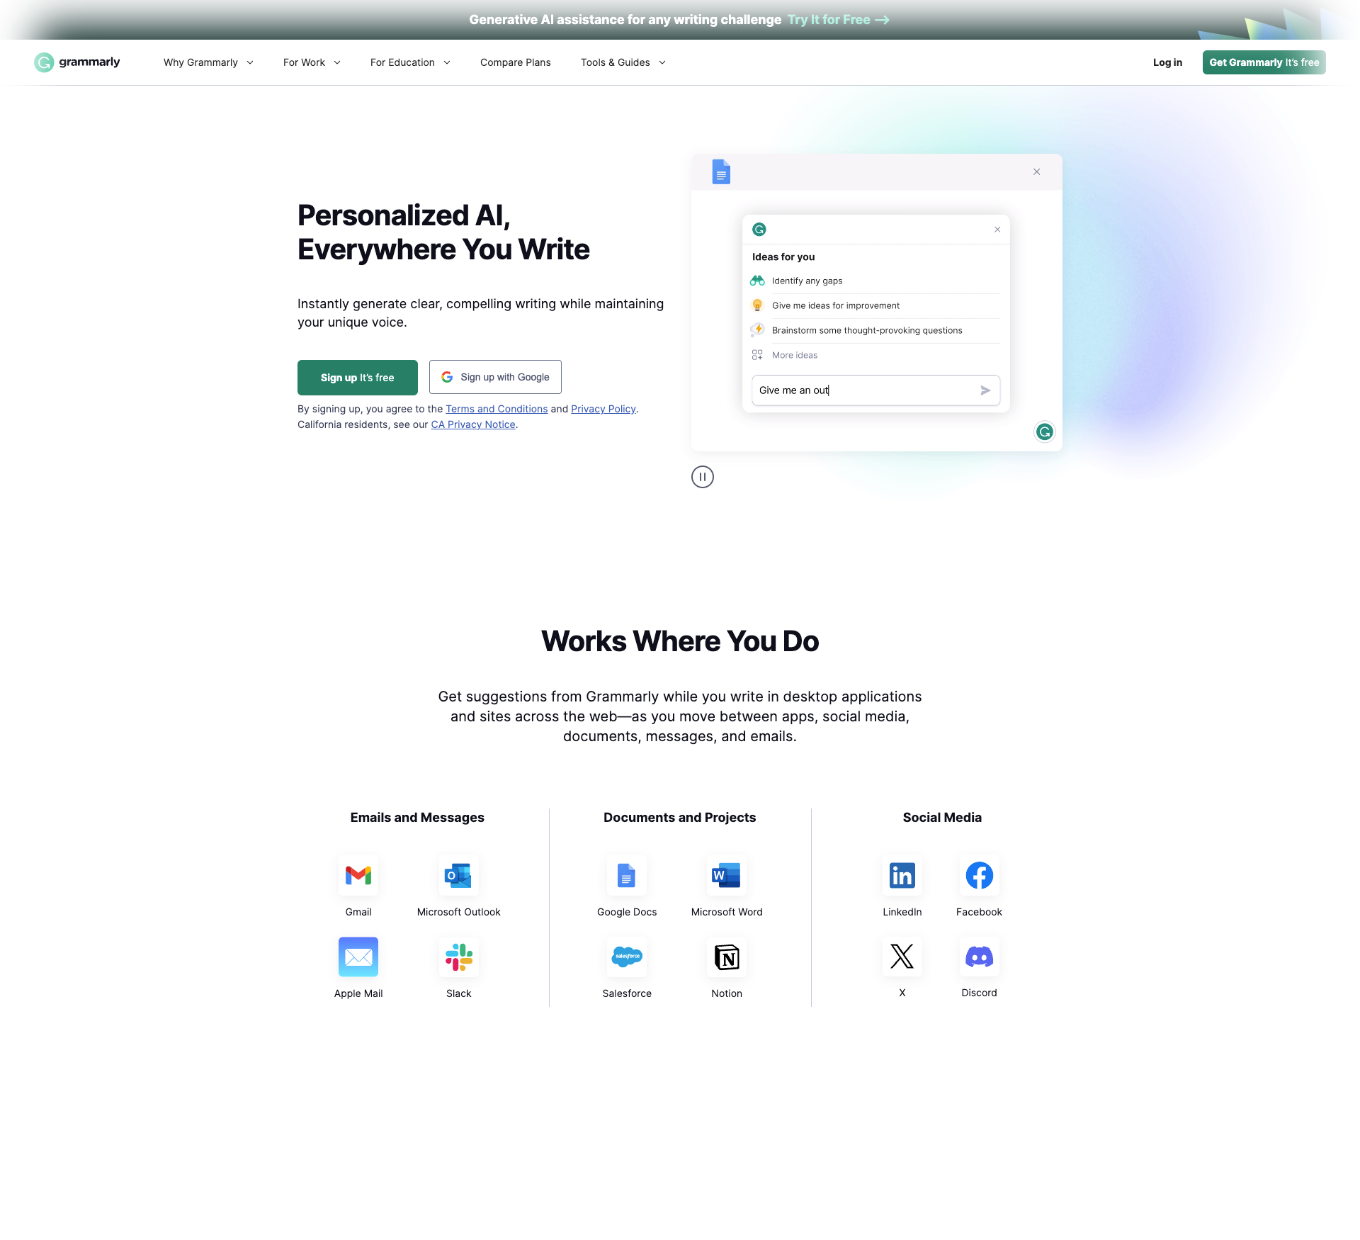
GRAMMARLY
Paid Subscription
Easy to use
AI Writing Assistant
Eliminate Grammar Errors
Fix Punctuation Errors
Tone Detector
Style Guide
Brand Tones
Notes:
It is Google Chrome or Microsoft Edge extension that link the chatbots.
Its beauty is that it not only uses ChatGPT, but also utilizes other AI chatbots like Bard, Claude, and Bing Chat.
The main benefit of using MaxAI over chatbots is that during the writing process, you will not need to open the AI tool separately; instead, you can use the AI directly on the same web page you are working on. This saves time that would otherwise be spent on switching tabs or windows and copying/pasting queries or responses.
Enhance your productivity to the next level for tasks such as writing, translating, summarizing, etc

Slide 16
THE CHATBOTS

Slide 17
CHAT-GPT
Free with daily limit
GPT-4 only available with a monthly subscription
Easy to use
Created by OpenAI (Microsoft stake)
Supports association innovation, content, marketing, researching, brainstorming, reiterating, ideas, data, trends, event planning etc.
3000 functional plugins
GPT-5 out before Christmas

Slide 18
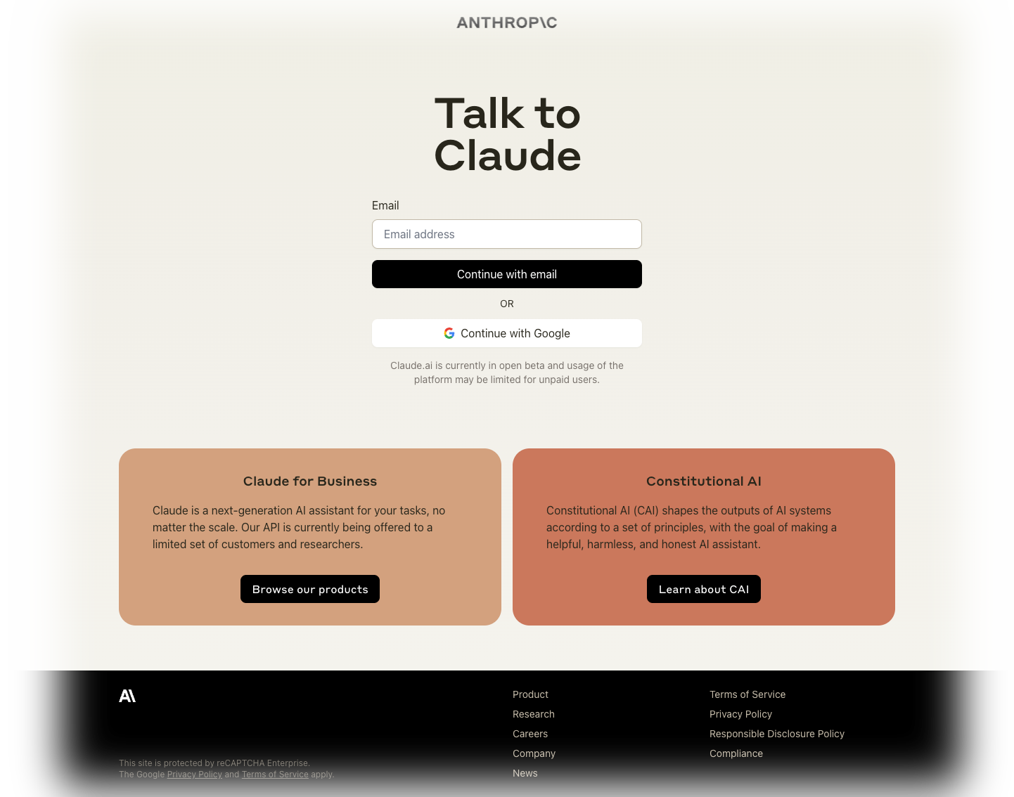
CLAUDE
Free
Easy to use, waiting list
Created by Anthropic (amazon stake).
Optimised to provide reliable responses and less false answers
Accepts high volumes data. Use for marketing, synthesising legislation, association data,
Notes:
since it is trained on training data. It is not connected to a search engine

Slide 19
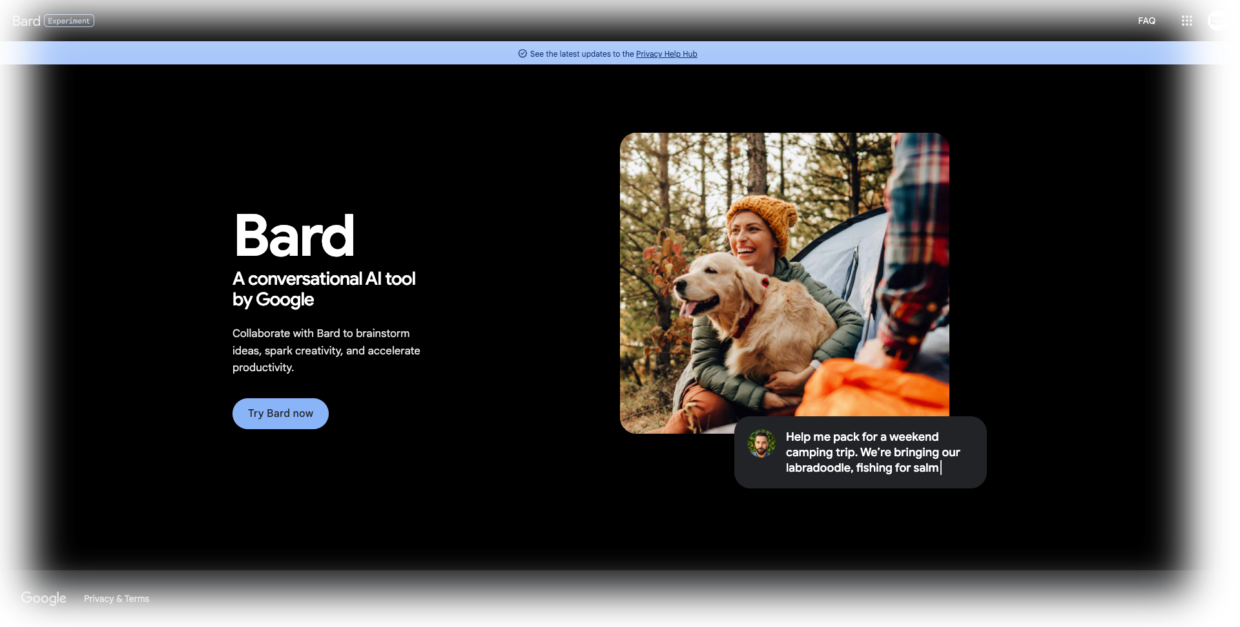
BARD
Free
Easy to use
Google’s chatbot for content marketing, brainstorming etc.
Pulls all its information from the web but it still hallucinates
Notes:
It is Google Chrome or Microsoft Edge extension that link the chatbots.
Its beauty is that it not only uses ChatGPT, but also utilizes other AI chatbots like Bard, Claude, and Bing Chat.
The main benefit of using MaxAI over chatbots is that during the writing process, you will not need to open the AI tool separately; instead, you can use the AI directly on the same web page you are working on. This saves time that would otherwise be spent on switching tabs or windows and copying/pasting queries or responses.
Enhance your productivity to the next level for tasks such as writing, translating, summarizing, etc

Slide 20
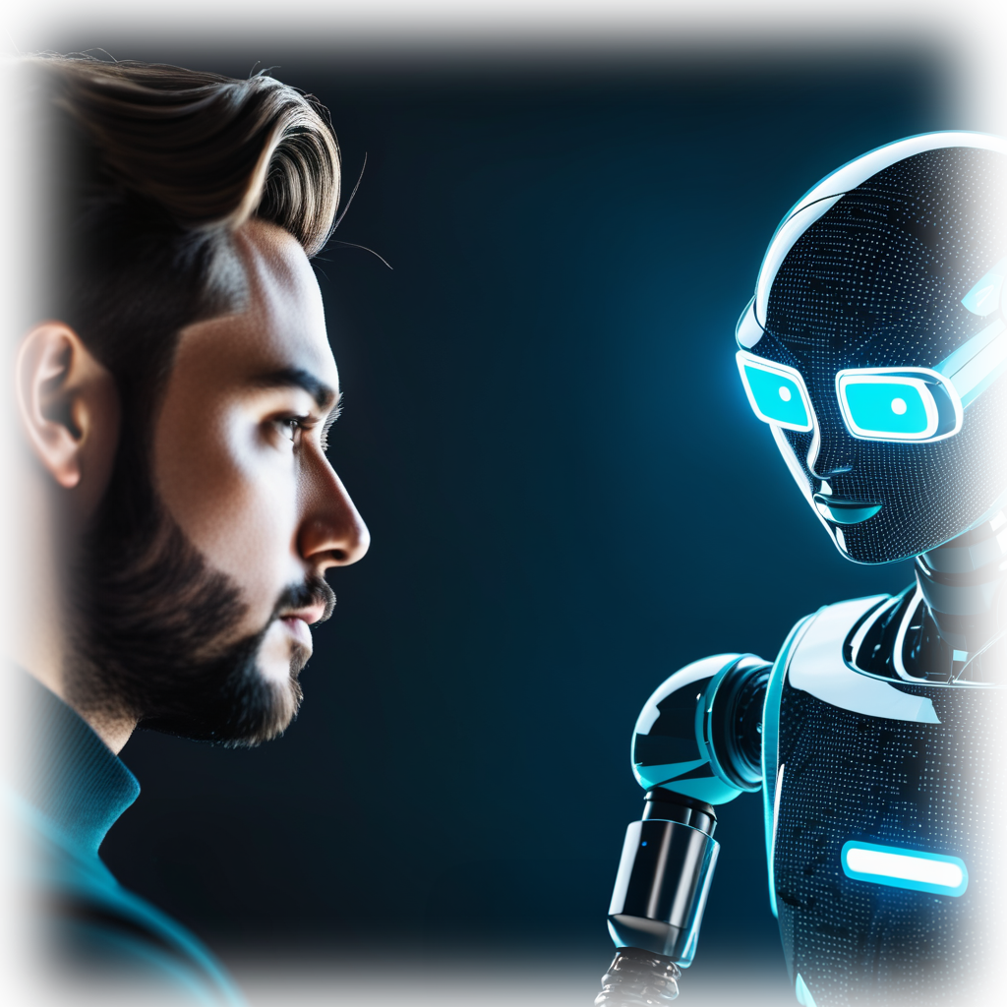
Top Tips
When prompting - add context - tone, audience, who you are
Simply say “make this better”
Share your vision and give as much context as possible
Ask AI to check facts to avoid hallucinations
Be legally compliant when sharing content on AI
Pay attention to escalating monthly subscriptions
Image generated by Midjourney

Slide 21
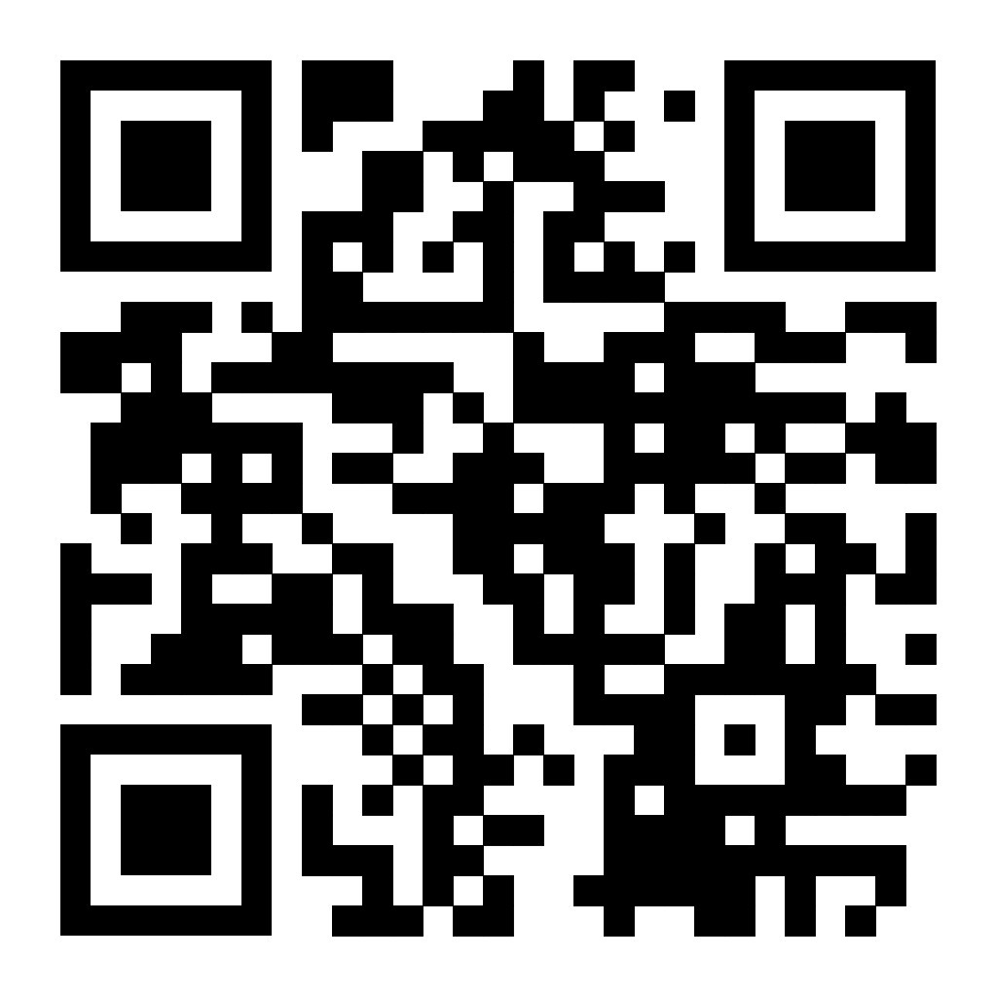
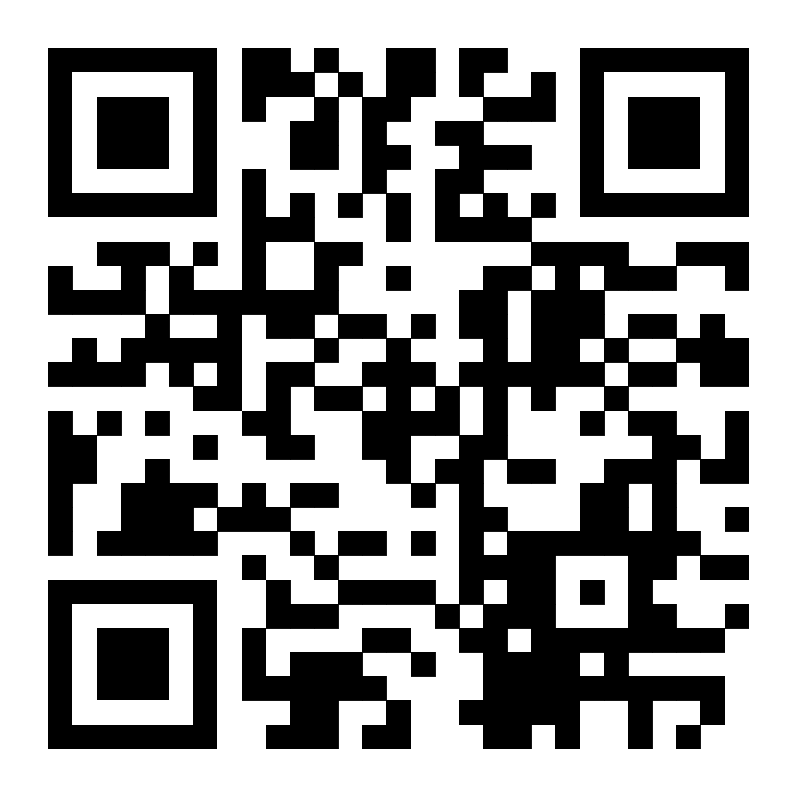
https://www.esae.eu/membership
For more information:
www.incon-pco.com/innovators-mindset

